Slide 1

CAP444 OBJECT ORIENTED PROGRAMMING USING C++

Slide 2


Constructor and destructor

Slide 3
Constructors: types of constructors
A special method which is used to initialize the object
It is automatically called when an object of a class is created.
it has the same name as the class name.
it is always public
it does not have any return type

Slide 4
Types of constructor:
Default constructor
Parameterized constructor
Copy constructor

Slide 5


Slide 6


Slide 8
Default constructor
A constructor which has no argument is known as default constructor. It is invoked at the time of creating object.
class Employee
{
public:
Employee()
{
cout<<"Default Constructor"<<endl;
}
};

Slide 9
Parameterized constructor
A constructor which has parameters is called parameterized constructor.
class Employee
{
int empId;
string empName;
public:
Employee(int id, string name)
{
empId=id;
empName=name;
}
};

Slide 10
Copy Constructor
Copy Constructor is a type of constructor which is used to create a copy of an existing object of a class.
Syntax:
class-_name(class_name & object_name)
{
}
To call this: class_name obj1(arguments);
class_name obj2 = obj1;

Slide 11
Destructor
Destructor is a special member function which destructs or deletes an object.
A destructor is called automatically when object goes out of scope.
Destructors have same name as the class preceded by a tilde (~)
Destructor should not have any parameter
There can only one destructor in a class
When a class contains a pointer to memory allocated in class, we should write a destructor to release memory

Slide 12
Which option is correct for defining the destructor?
Option1:
~mobile()
{
cout<<"destructor called"<<endl;
}
Option2:
~mobile( string str)
{
cout<<"destructor called"<<endl;
}
Option1 is correct
Option2 is correct
Both option is correct

Slide 13



father
mother
child

Slide 14



More examples of inheritance:
Contact List

Slide 15

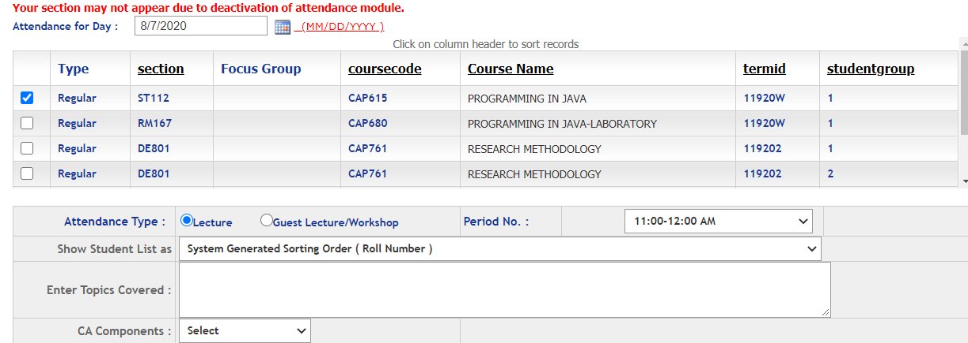
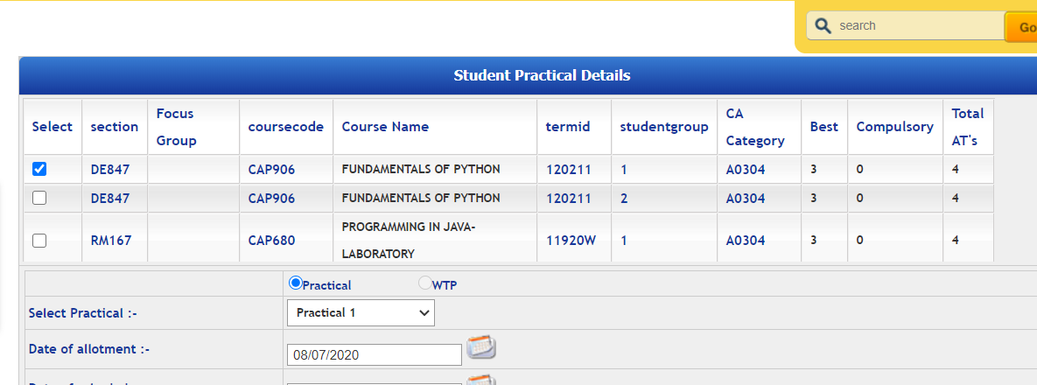
Students
More examples of inheritance:
Students in Attendance Module
Same Students in CA Module

Slide 16
Inheritance: types of inheritance
One class can hire properties from other class
Advantages: Reusability
A
A
A
B
B
B
C
C
Single
Multilevel
Multiple

Slide 17
A
A
B
C
B
C
Hierarchical Inheritance
D
Hybrid Inheritance

Slide 18
Which among the following best defines single level inheritance?
A) A class inheriting a derived class
B) A class inheriting a base class
C) A class inheriting a nested class
D) A class which gets inherited by 2 classes

Slide 19
Single inheritance:
Syntax:
class derive_class_name : access_mode base_class_name
{
//body of derive_class
};

Slide 20
Multiple Inheritance:
class derive_class_name : access_mode base_class1, access_mode base_class2, ....
{
//body of derive_class
};

Slide 21
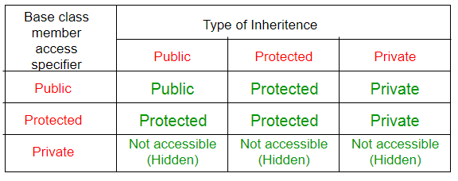
class base_class
{
//base class members (x, y)
};
class derive_class : access_Specifier base_class
{
//base class members (x, y)
//derive class members (a,b)
};

Slide 22
Which among the following is correct for a hierarchical inheritance?
a) Two base classes can be used to be derived into one single class
b) Two or more classes can be derived into one class
c) One base class can be derived into other two derived classes or more
d) One base class can be derived into only 2 classes

Slide 25
Any Query?

